Slide 1
SUPPORT VECTOR MACHINES
-By Team
Wednesday

Slide 2
What is Support Vector Machine?
“Support Vector Machine” (SVM) is a supervised machine learning algorithm which can be used for both classification or regression challenges.
However, it is mostly used in classification problems.
In this algorithm, we plot each data item as a point in n-dimensional space (where n is number of features you have) with the value of each feature being the value of a particular coordinate.

Slide 3
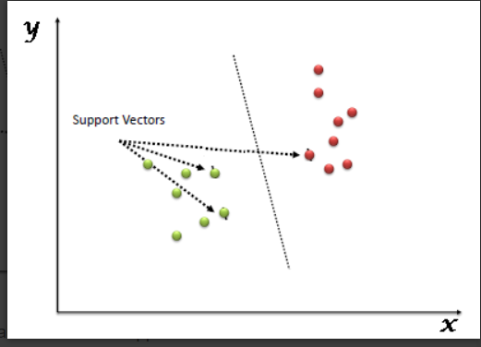
Support Vectors
Support Vectors are simply the co-ordinates of individual observation. Support Vector Machine is a frontier which best segregates the two classes (hyper-plane/ line).

Slide 4
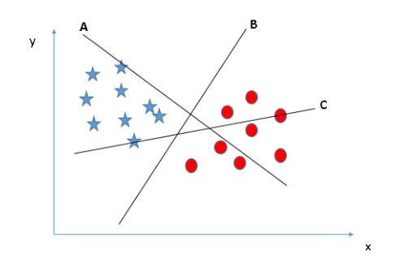
How does it work?
Identify the right hyper-plane (Scenario-1): we have three hyper-planes (A, B and C).
The thumb rule to identify right hyper-plane: “Select the hyper-plane which segregates the two classes better”. In this scenario, hyper-plane “B” has excellently performed this job.

Slide 5
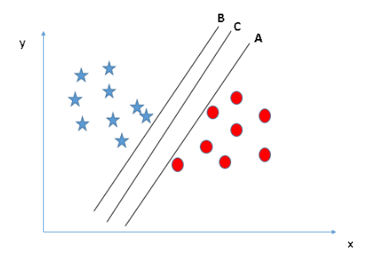
Identify the right hyper-plane (Scenario-2): Here, we have three hyper-planes (A, B and C) and all are segregating the classes well.
Maximizing the distances between nearest data point (either class) and hyper-plane will help us to decide the right hyper-plane. This distance is called as Margin.

Slide 6
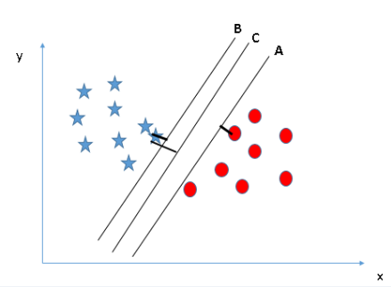
The margin for hyper-plane C is high as compared to both A and B. Hence, we name the right hyper-plane as C. If we select a hyper-plane having low margin then there is high chance of miss-classification.

Slide 7
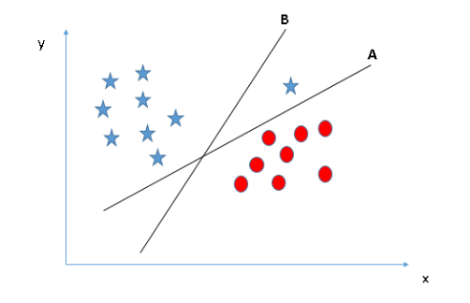
Identify the right hyper-plane (Scenario-3): Select the hyper-plane B as it has higher margin compared to A. But, SVM selects the hyper-plane which classifies the classes accurately prior to maximizing margin. Hyper-plane B has a classification error and A has classified all correctly. Therefore, the right hyper-plane is A.

Slide 8
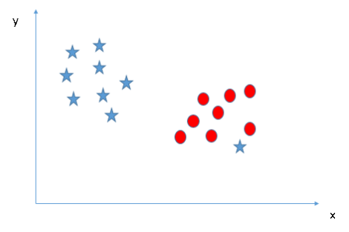
Classifying two classes (Scenario-4):segregate the two classes using a straight line, as one of star lies in the territory of other(circle) class as an outlier.

Slide 9
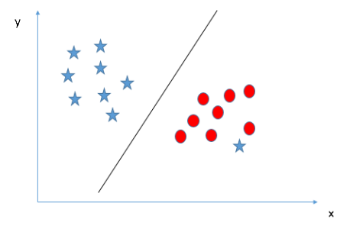
One star at other end is like an outlier for star class. SVM has a feature to ignore outliers and find the hyper-plane that has maximum margin. Hence, we can say, SVM is robust to outliers.

Slide 10
https://www.youtube.com/watch?v=Y6RRHw9uN9o&t=301s

Slide 11
Applications of SVM in real world.
Face detection
Text and hypertext categorization
Classification of images
Bioinformatics
Protein fold and remote homology detection
Handwriting recognition
Generalized predictive control(GPC)

Slide 12
Pros and Cons associated with SVM
Pros:
Clear margin of separation
High dimensional spaces.
It is effective in cases where number of dimensions is greater than the number of samples.
It uses a subset of training points in the decision function (called support vectors), so it is also memory efficient
Cons:
It doesn’t perform well
SVM doesn’t directly provide probability estimates

